Slide 1
Digital portfolio
STUDENT NAME :UZMA PARVEEN. S
REGISTER NO:34624U09098
NM ID : ASTVU346M24323
DEPARTMENT:BCA
COLLEGE:MMES WOMEN’S ARTS AND SCIENCE COLLEGE, THIRUVALLUVAR UNIVERSITY

Slide 2
Web folio
MY DIGITAL PORTFOLIO

Slide 3
AGENDA
Problem Statement Project Overview End Users Tools and Technologies Application Design and Layout Features and Functionality Results and Screenshots Conclusion GitHub Link

Slide 4
PROBLEM STATEMENT
Difficulty in showcasing skills and projects through traditional resumes Limited space in CVs to highlight creativity Lack of an interactive and accessible way to present personal/professional details

Slide 5
PROJECT OVERVIEW
A personal website showcasing academic, technical, and creative work Acts as a digital portfolio for career and academic opportunities Responsive design for accessibility across devices

Slide 6
END USERS
Students Job seekers Recruiters & HR professionals Academic institutions

Slide 7
TOOLS AND TECHNOLOGIES
HTML – Structure of web pages CSS – Styling and layout JavaScript – Interactivity

Slide 8
PORTFOLIO DESIGN AND LAYOUT
Home page with introduction About section with personal details Skills and projects showcase Contact form for communication Clean, modern, and user-friendly interface

Slide 9
FEATURES AND FUNCTIONALITY
Responsive design (mobile & desktop) Easy navigation menu Interactive project showcase Contact form integration Links to social media & GitHub

Slide 10
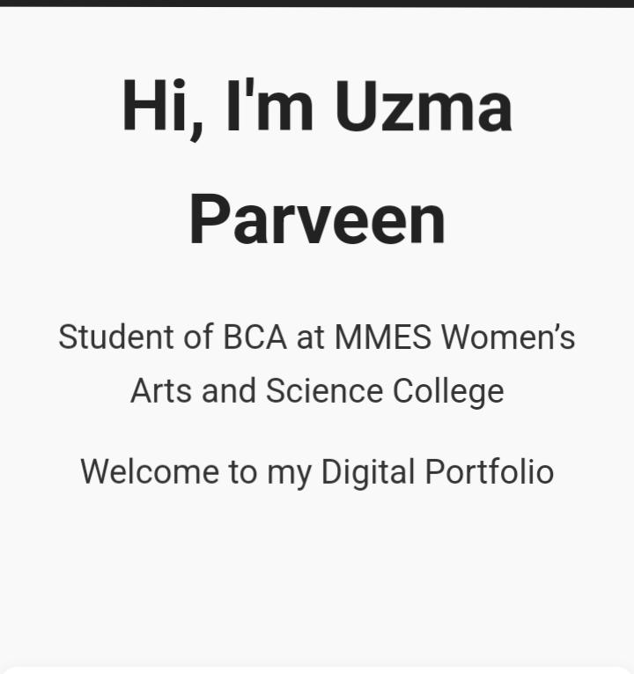
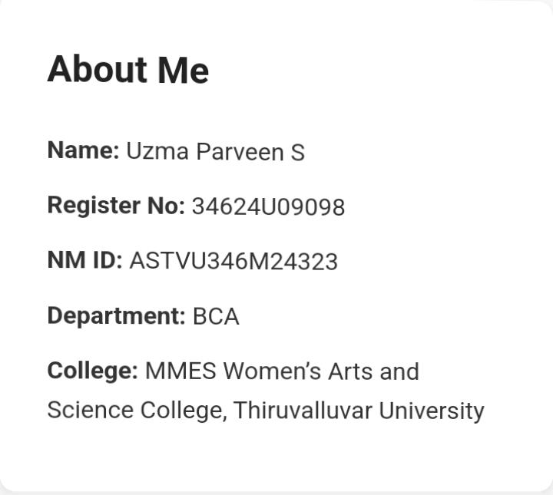
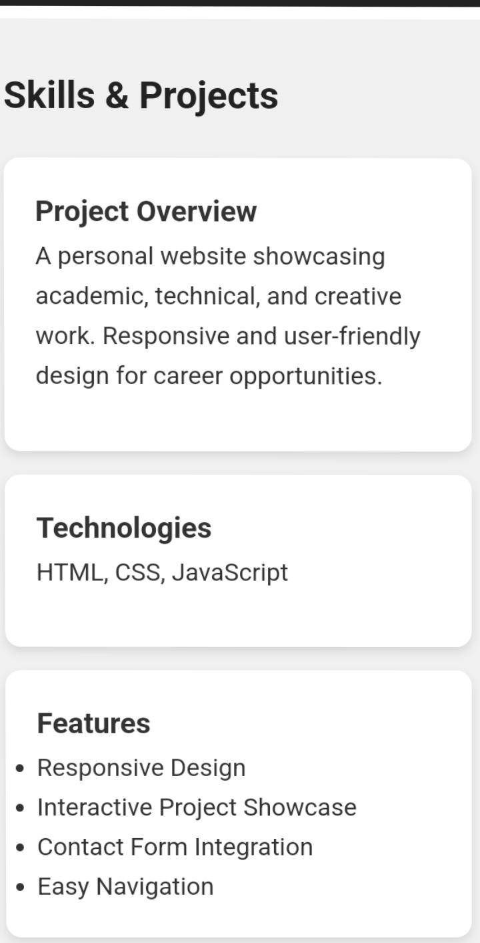
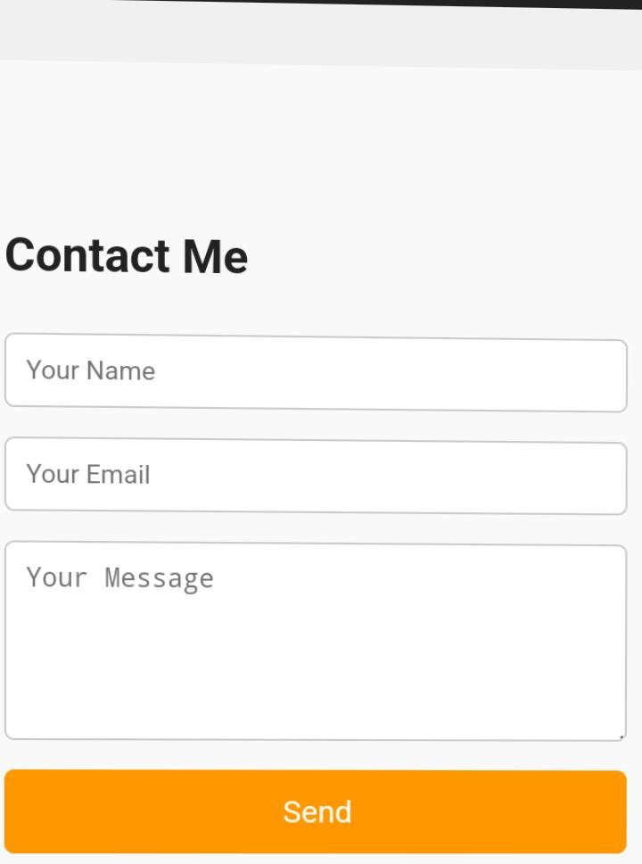
RESULTS AND SCREENSHOTS

Slide 11
CONCLUSION
A Web Folio serves as an effective digital resume Enhances chances of employment and networking Can be regularly updated with new skills and projects

Slide 12
GITHUB LINK
https://uzma72756-alt.github.io/Web--folio/
Thank you….🤍

